Slide 1
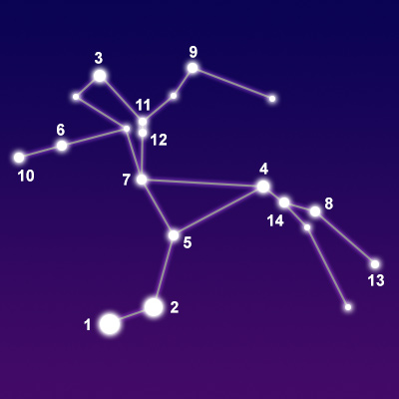
Analyzing Constellations Using Graph Theory
Kritika Verma
Siddhartha Mahajan

Slide 2
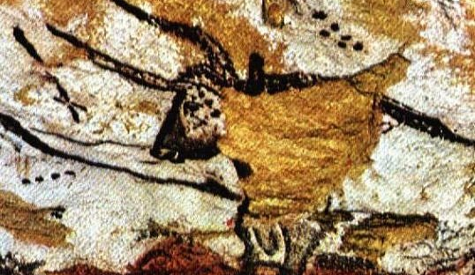
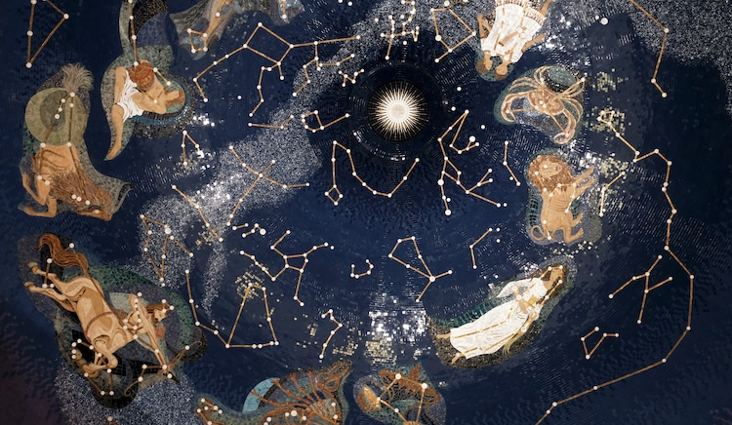
Introduction
Humans have been seeing and studying the stars since forever.
During all that time, many of them have found apparent shapes in the distribution of the stars.
These shapes or constellations have been a part of human culture and religion since forever.
Its an ability of the human mind to find patterns everywhere, even if there are none.
If we see the stars as vertices and the lines of the constellations as edges, the constellations are all graphs.
We've tried to find the properties of these graphs.

Slide 3
Methodology – Hamilton Path/Circuit
We found a reliable and easy-to-understand algorithm for finding the Hamiltonian Path/Circuit. It works by backtracking. The steps of the algorithm are:
1. Put vertex 0 as the first vertex in the path. If there is a Hamiltonian Cycle, then the path can be started
from any point of the cycle as the graph is not directed.
2. Move to the next vertex.
3. Check if this vertex is an adjacent vertex of the previously added vertex and is not included in the path earlier.
4. Try different vertices as the next candidate in Hamiltonian Cycle.
5. If all vertices are included in the path. The last vertex must be adjacent to the first vertex in the path to make a cycle.
6. Remove the current vertex if it doesn’t lead to a solution and keep repeating steps 4 and 3.

Slide 4
Methodology –Eulerian Path/Circuit
The algorithm to find the Eulerian Path/Circuit is: 1. Find out the degrees of all vertices. Add all the entries in a row of the Adjacency matrix to get the degrees of the vertex that row represents. 2. Check if all non-zero degree vertices are connected. 3. If all of them have an even degree, then we have an Eulerian Circuit. 4. If two of them have odd degrees and the rest have even degrees then we have an Eulerian Path. 5. Do a DFS (Depth First Search) traversal starting from a node with non-zero degree. Create a recursive function that takes the index of the node and creates a visited array. • Mark the current node as visited and print the node. • Traverse all the adjacent and unmarked nodes and call the recursive function with the index of the adjacent node.

Slide 5
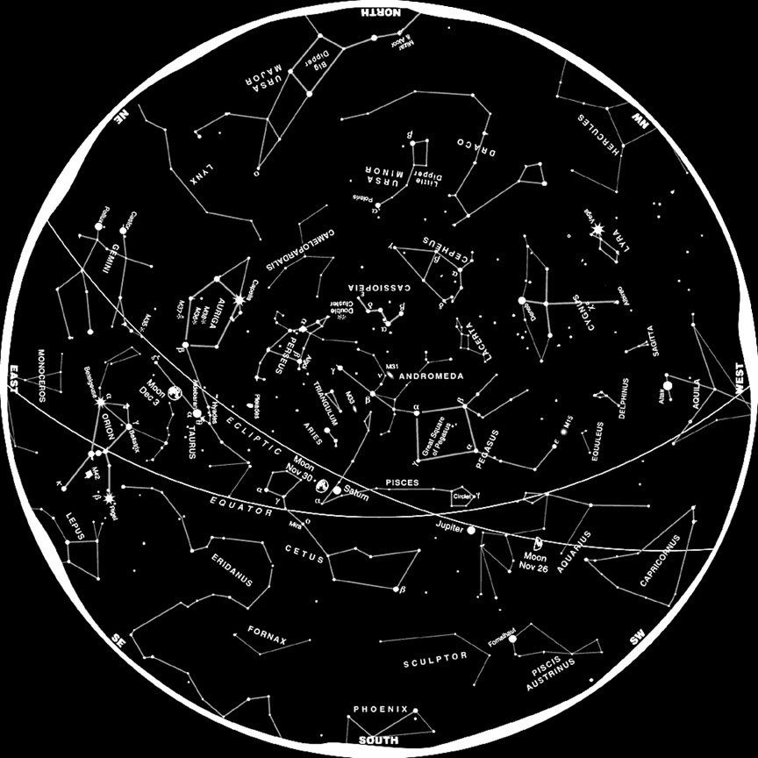
Constellations
There are 88 official constellations recognized by IAU.
More than half of these are not connected graphs.
We took the 31 constellations with connected graphs and tried to find their Hamiltonian path/circuit and Eulerian path/circuit.
We found these paths using the adjacency matrix of the given constellations which we got by taking the edges of the graph as inputs.

Slide 6
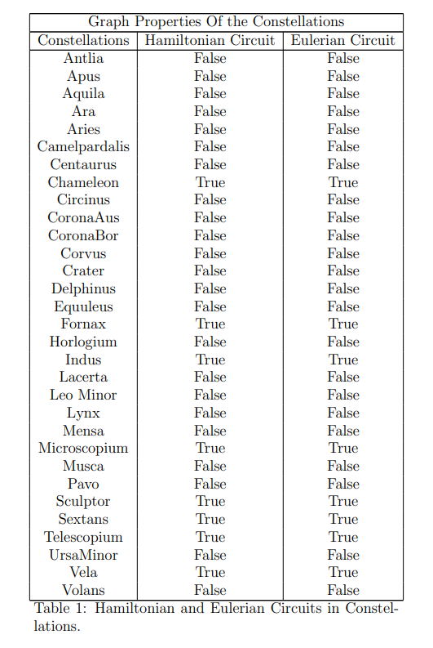
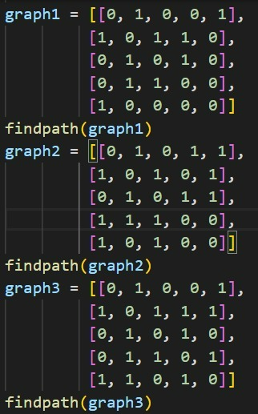
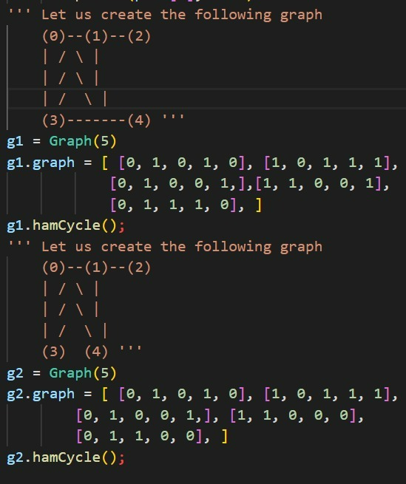


Results

Slide 7
THANK YOU
KRITIKA VERMA
SIDDHARTHA MAHAJAN

